Slide 1



Welcome!!!
What is a GO TEAM?
Team of school & community members collaborating on budget, strategic plan, etc.
May 1, 2023

Slide 2
Call to Order/Norms
This is a meeting of the GO Team. Only members of the team may participate in the discussion. Any members of the public present are here to quietly observe.
We will be fully present.
We will follow the agenda as noticed to the public and stay on task.
We will be respectful of each other at all times.
We will be open-minded.
We invite and welcome contributions of every member and listen to each other.
We will respect all ideas and assume good intentions.
We will approach differences of opinion with curiosity.

Slide 3
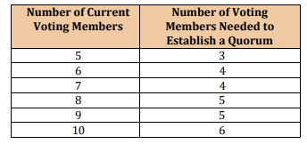
Roll Call & Quorum
Role | Name | Email
Principal (upper school) | Emanuel Mathis | emathis@kippmetroatlanta.org
Principal (lower school) | Tara Stifler | tstifler@kippmetroatlanta.org
Parent/Guardian | Quinicha Hartsfield | qhartsfield@gmail.com
Parent/Guardian | Tetra Savoy | tetrasavoy@yahoo.com
Parent/Guardian | Kadonna Lee | klee@kippmetroatlanta.org
Parent/Guardian | Iyhonna Smith | iyhonna.smith@gmail.com
Instructional Staff | Asia Harris, Chair | aharris2@kippmetroatlanta.org
Instructional Staff | Ayjah Byrd | abyrd@kippmetroatlanta.org
Instructional Staff | Ensa Womack | ewomack@kippmetroatlanta.org
Instructional Staff | Cassandra Aaron | caaron@kippmetroatlanta.org
Community Member | April Jordan | jordan@groveparkfoundation.org
Community Member | Maureen Sanchez | sanchez@groveparkrenewal.org
Swing Seat | Erin Nickson | erin.nickson@cancer.org
Those in blue are voting members.

Slide 4
Approval of Agenda
Meeting Agenda
This meeting [will/will not] allow for Public Comment.
Call to Order
Roll Call; Quorum Established
Action Items
Approval of Agenda
Approval of Previous Minutes
Discussion Items
Douglass Cluster Re-zoning Decision
STAR K-8 Preliminary EOY Results
Principal’s Report
Announcements
Public Comments (1-2 minutes)
Adjournment
Notes:
Ask for a motion to approve
Ask for a second

Slide 5
Approval of Minutes
KWPA GO Team Site
Notes:
Ask for a motion to approve previous minutes (once show them)
Ask for a second

Slide 6

Discussion Items
Douglass Cluster Re-Zoning Decision
STAR Preliminary Results for EOY Testing K-8
  Discussion around Data Presented
Notes:
SAY: We know at the last few go teams, we discussed the 3 different options the district was considering to adjust the overcrowding in KWPA, specifically in grades K-4. There were 3 options–1 to not rezone, and 2 to rezone in different ways. The decision was made NOT to rezone at all. This means that APS will use innovation to address the overcrowding. Meetings wil begin with the district to align on the innovations that will happen at KWPA (the same is true for the Midtown and Jackson clusters that were also facing the same overcrowding)
The decision was made after hearing from numerous stakeholders including family and community members

Slide 7
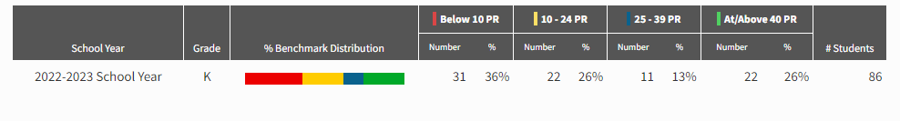
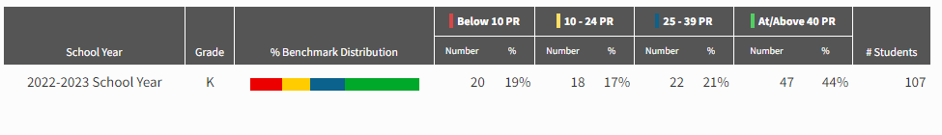
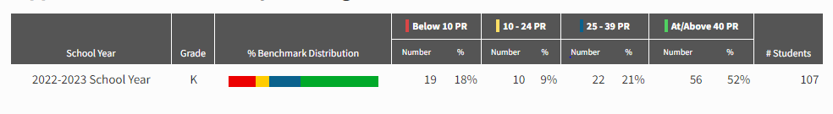
STAR 360 Screener Results: Kindergarten Early Literacy
Notes:
SAY: on all slides it shows our progression from Beginning of Year, to Middle of Year, to most recently End of Year
Still finishing final make-ups for all grade.
Don’t yet have regional growth reports or comparative reports across all KMA schools

Slide 8
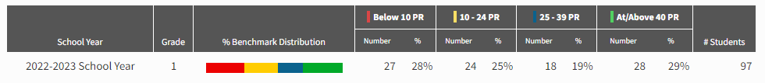
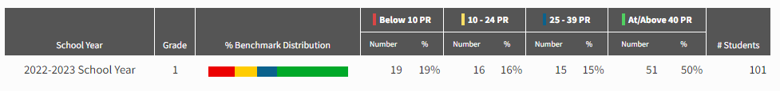
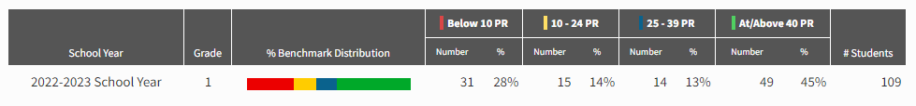
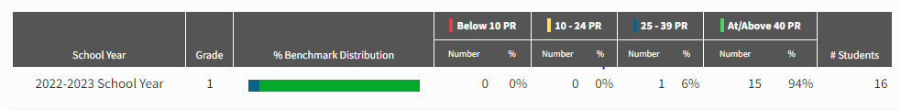
STAR 360 Screener Results: 1st Grade: Early Lit
Notes:
SAY: The bottom row on this slide is scholars who took the reading assessment. Based on middle of the year scores, 16 scholars were identified as ready to take the reading (grades 3-8) assessment. This assessment is not read to you.

Slide 9
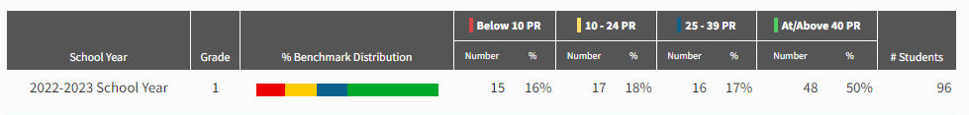
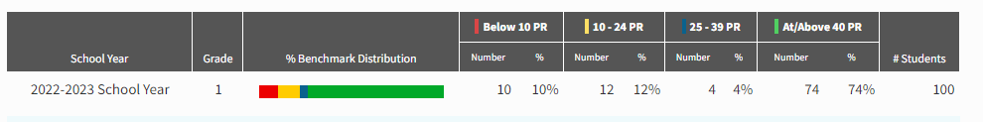
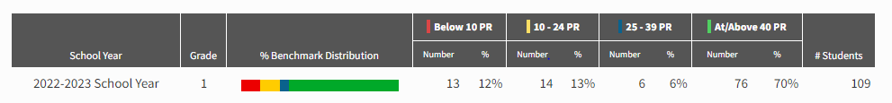
STAR 360 Screener Results: 1st Grade Math
Notes:
Math

Slide 10
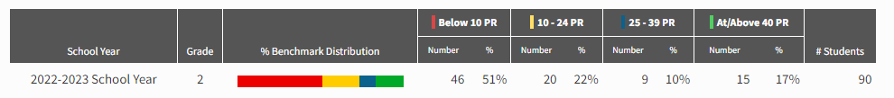
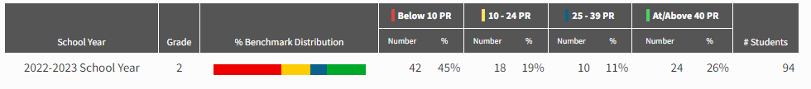
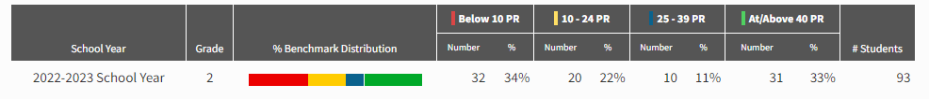
STAR 360 Screener Results: 2nd Grade Early Lit
Notes:
Early Lit on Top
Math on Bottom

Slide 11
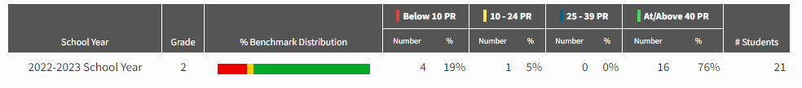
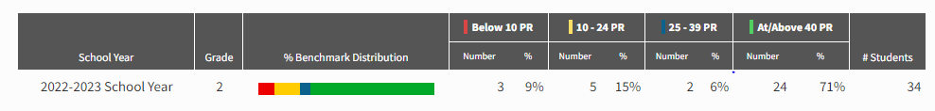
STAR 360 Screener Results: 2nd Grade Reading
Notes:
SAY:These are the scholars in grade 2 who also took the reading, not early literacy, assessment. 21 took it in December and 34 scholars this spring. That is almost ⅓ of the whole grade which is excellent! (Scholars transition to reading assessment in Beginning of grade 3)

Slide 12
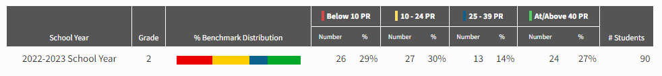
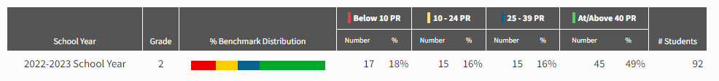
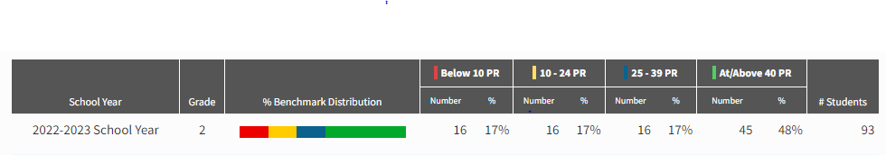
STAR 360 Screener Results: 2nd Grade Math

Slide 13
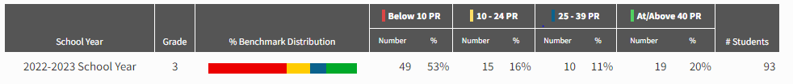
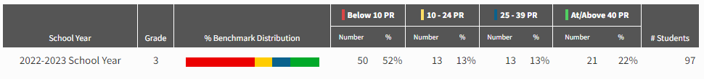
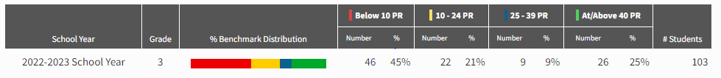
STAR 360 Screener Results: 3rd Grade: Reading

Slide 14
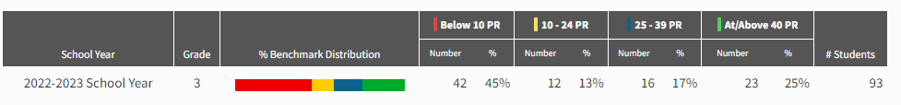
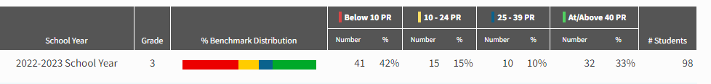
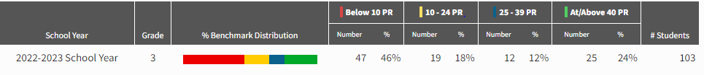
STAR 360 Screener Results: 3rd Grade: Math

Slide 15
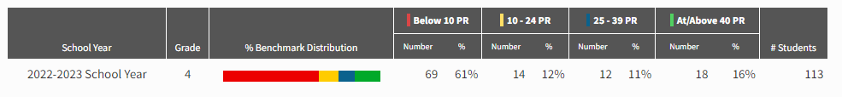
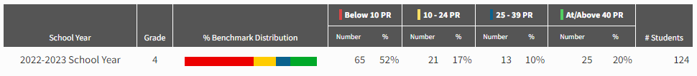
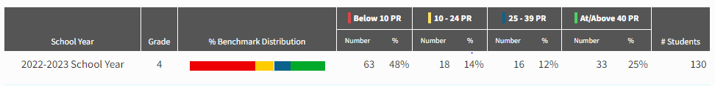
STAR 360 Screener Results: 4th Grade: Reading

Slide 16
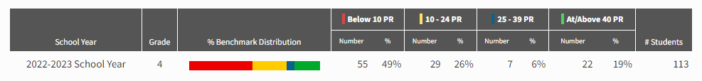
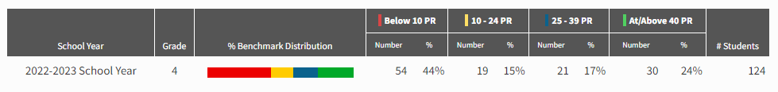
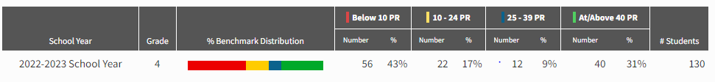
STAR 360 Screener Results: 4th Grade: Math

Slide 17
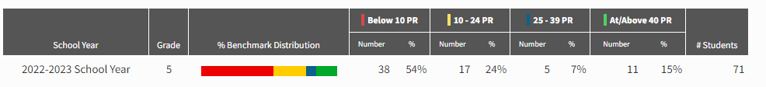
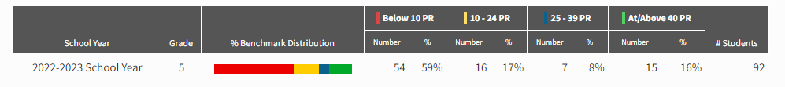
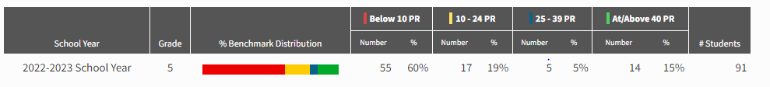
STAR 360 Screener Results: 5th Grade: Reading

Slide 18
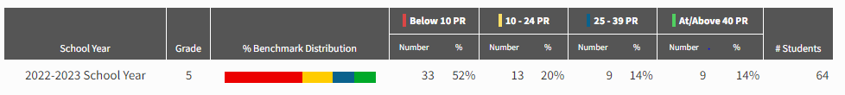
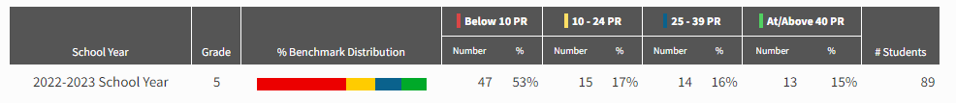
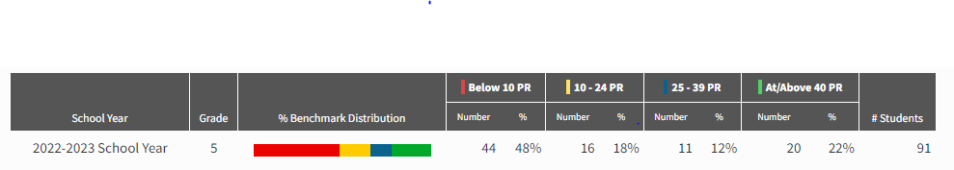
STAR 360 Screener Results: 5th Grade: Math

Slide 19

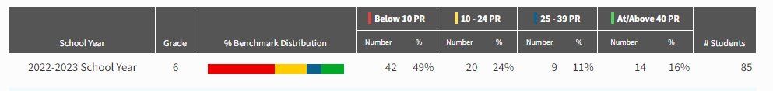
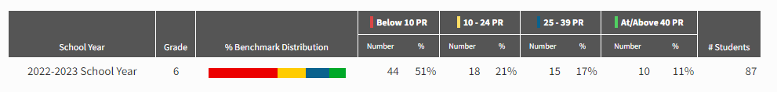
STAR 360 Screener Results: 6th Grade: Reading

Slide 20
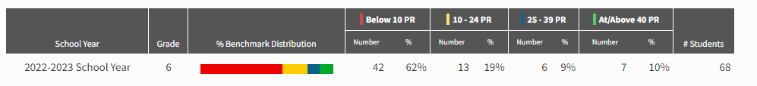
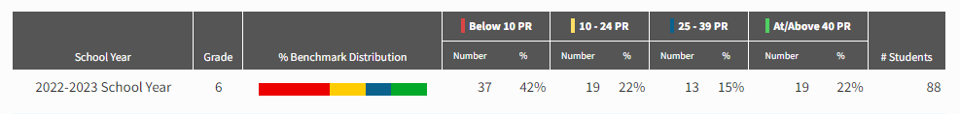
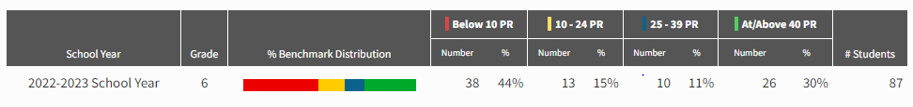
STAR 360 Screener Results: 6th Grade: Math

Slide 21
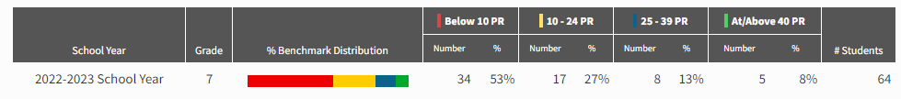
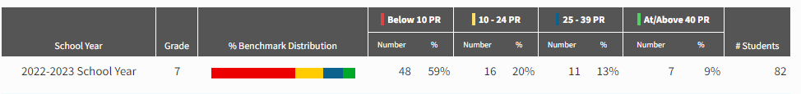
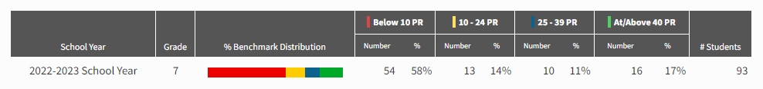
STAR 360 Screener Results: 7th Grade: Reading

Slide 22
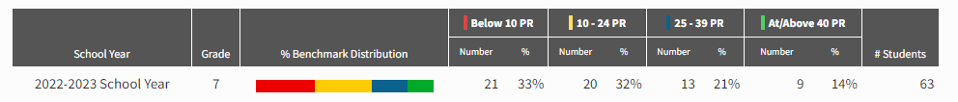
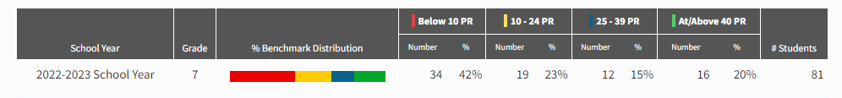
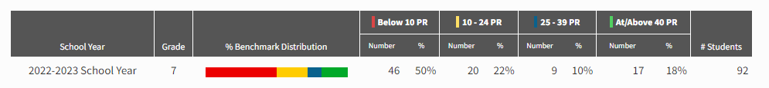
STAR 360 Screener Results: 7th Grade: Math

Slide 23
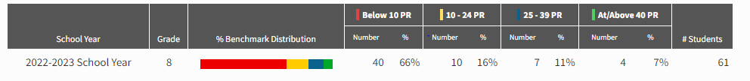
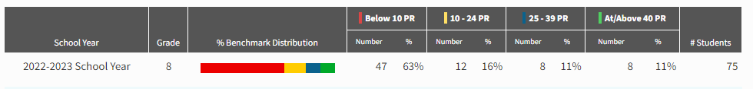

STAR 360 Screener Results: 8th Grade: Reading

Slide 24



STAR 360 Screener Results: 8th Grade: Math

Slide 25
Reports
Principal:
End of Year Calendar
  4 weeks!
  Milestones began today, runs through May 15
  Field Day: May 16th upper school, May 18th lower school
  Field Trips: May 16th lower school, May 18th upper school
  8th Grade Parent Dinner & Dance: May 18th
  8th Grade Graduation: May 19th
  Grade 8 DC Trip: Begins May 22nd
  Kinder & 4th Grade Bridging: May 23rd
  5th-7th Awards: May 24th
  1st-3rd Awards: May 25th
  Last Day of School!: May 26th
  May 22nd-May 26th all 1:45 release days
Go Team Trainings
Notes:
Information Items
SAY: We will now move on to Information Items; first is the Principal’s Report.

Slide 26

Reports
Principal:
Go Team Trainings
New Go Team Voting
Notes:
STIF STILL

Slide 27
Public Comment
1-2 minutes per stakeholder
Notes:
SAY: Ask if anyone from the public wishes to comment at this time
2 minutes per public comment if applicable
Proceed if no

Slide 28
Information Items - Announcements
Any additional announcements?

Slide 29

Adjourn

